Slide 1


Amazon Sales Case study
By: Shivam Rai

Slide 2
Purpose Of Project:
The major aim of this project is to gain insight into the sales data of Amazon to understand the different factors that affect sales of the different branches.
Product Analysis
Sales Analysis
Customer Analysis

Slide 3
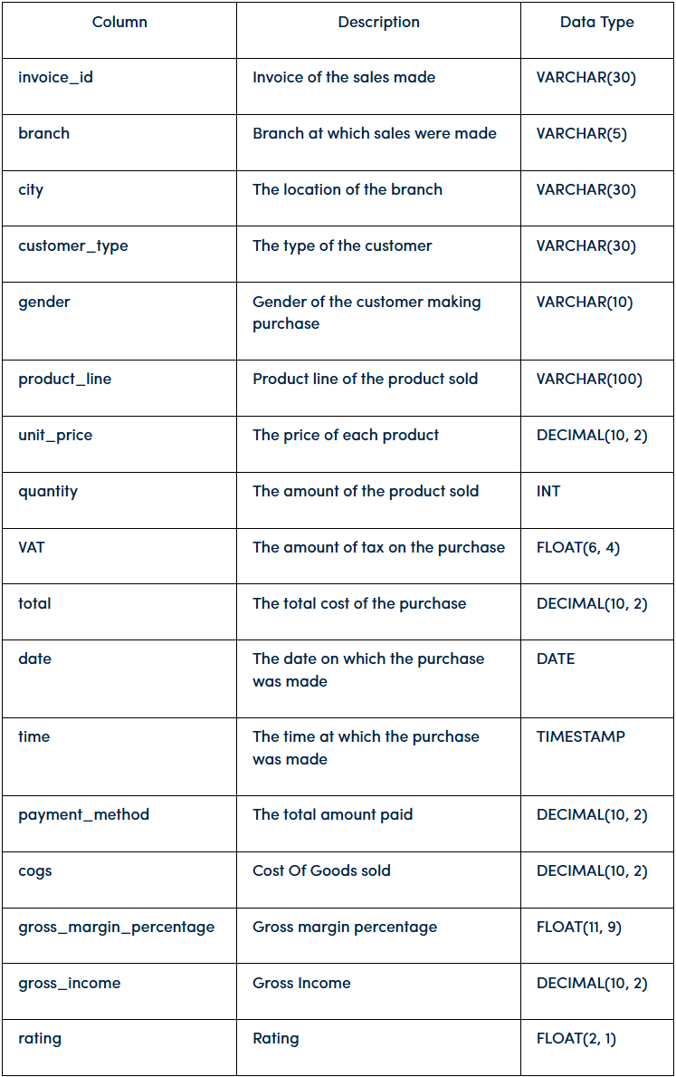
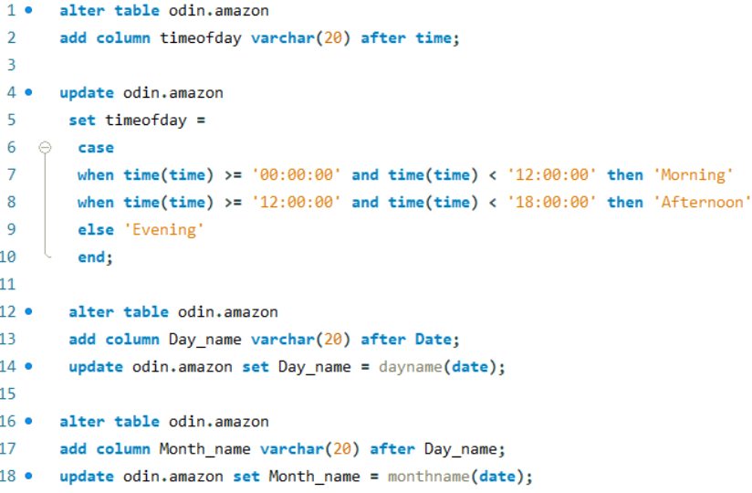



About Data & Feature Engineering:
This dataset contains sales transactions from three different branches of Amazon, respectively located in Mandalay, Yangon and Naypyitaw.
The data contains 17 columns and 1000 rows:

Slide 4
Location analysis:
There are 3 distinct cities in data and each of this city.
Branch A:
Yangon
Branch B:
Naypyitaw
Branch C:
Mandalay
From the 3 cities the Naypyitaw was found to have the highest VAT percentage .

Slide 5
Product analysis:
There are 6 distinct product lines.
Food & Beverages
Average Rating: 7.11
Fashion accessories
Average Rating: 7.03
Health and beauty
Average Rating: 7
Electronic accessories
Average Rating: 6.92
Sports and travel
Average Rating: 6.92
Home and lifestyle
Average Rating: 6.84

Slide 6
Sales analysis:
The Fashion accessories is the most in demand product line closely followed by Food & Beverages and Electronic accessories.
Food & Beverages booked the highest revenue of all other product lines but at the same time they were also subjected to highest VAT.
Branch B i.e. Naypyitaw clocked the highest revenue although more quantity of goods were sold at Branch A i.e. Yangon.

Slide 7
Sales analysis:
The inflow of orders generally peaks during afternoon each day

Slide 8
Customer analysis:
The most preferred mode of payment by customers is E-wallet followed by Cash & Credit Card.
Customers with Membership were responsible for more revenue and higher purchase frequency than normal customers and at the same time they also faced higher VAT than normal customers.

Slide 9
Customer analysis:
The product line of Fashion accessories and Food & Beverages are more associated with Female customers while Males customers are more associated with Health & Beauty product line.
There are more number of Male customer for branch A & B but for branch C the no. of Female customers were higher.

Slide 10
Customer analysis:
Chances of customers giving a review or rating to a product is higher in afternoon.
This pattern of customers providing more ratings in afternoon becomes more clear if we see for each specific branch well except for Branch B.
The best weekday where customers provide more rating than average for each branch is

Slide 11


